Slide 1
NYSDOT 2021 DPS data collection update
Brendan Rock, P.E.
NYSDOT Materials Bureau
TPF-5 (443) Meeting
November 10, 2021

Slide 2
2020 - 2022
2020
DPS was included on 3 jobs
Called for data collection over the entire mat, reported in 100ft segments.
2021
DPS was included on ~11 jobs
2022
Look to continue increasing the frequency of use and include special specification on D contracts
This year we called for 1 mile or 50% of paved area whichever was greater.
Added a required summary sheet indicating core density, nuclear gauge readings, and DPS measurement at core locations.
Reducing required number of pucks

Slide 3
Continued work
Developing data expectations from a QA point of view
Further develop the summary reports and scale back the amount of data collected to reflect acceptance style testing rather than a QC testing.
Active promotion
NYSDOT regions
Contractors
Consultants
Producers
Evaluating Trends
Databasing all our data to evaluate trends in the comparisons between the DPS, cores, and nuclear density measurements

Slide 4
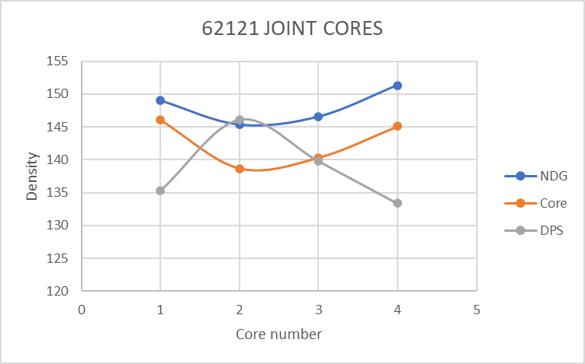
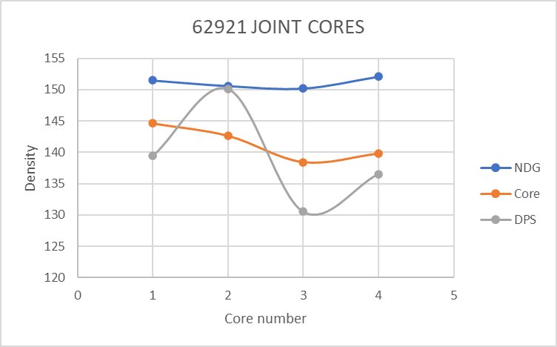
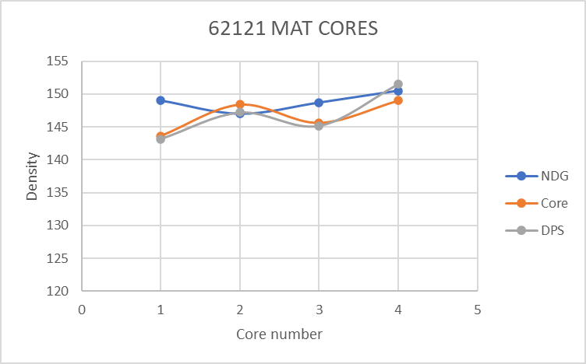
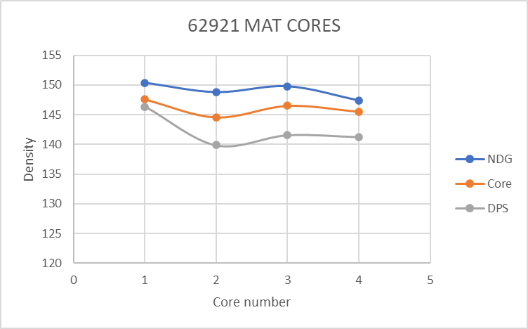

Slide 5
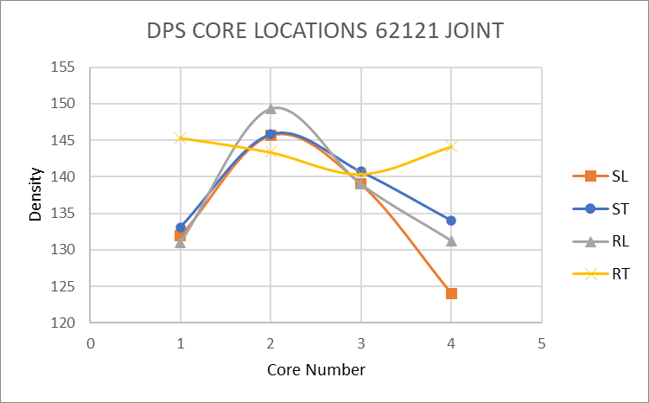
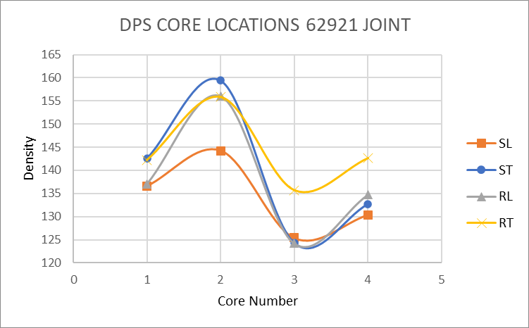
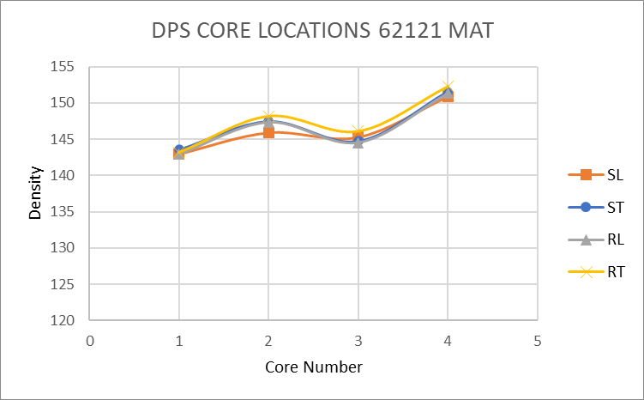
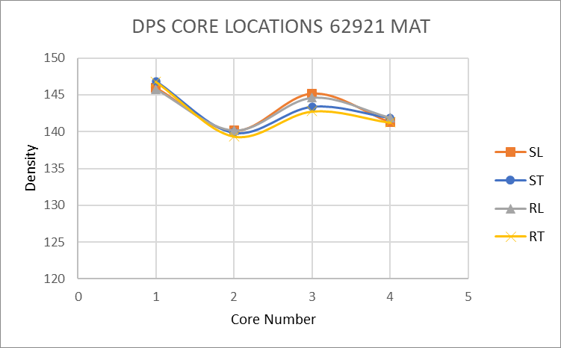

Slide 6
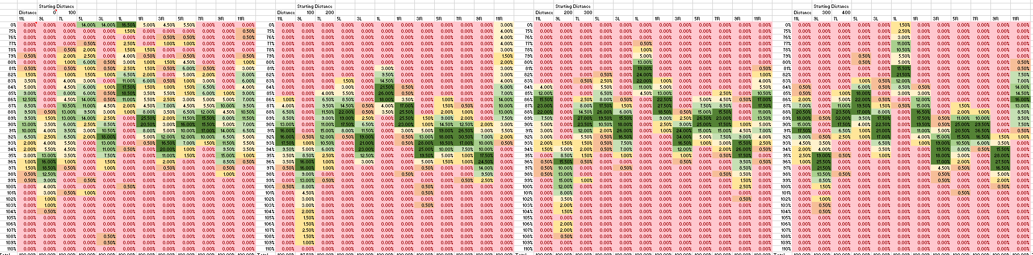
Developments
New resource investments in NYSDOT’s program
Reorganized some of Material Bureau to allow for a work group to dedicate more substantial time to DPS and other GPR activities
Statistical modeling of data
We are in the early stages of developing our statistical model for the data.
100ft segment density histograms.

Slide 7
Challenges
Limited resources for data collection
With the increase in number of jobs this year we are starting to reach the limit of our consultant’s capacity.
1 consultant with 2 meters.
Data turnaround time
Developing more specific summary pages puts more processing time on the consultant which will delay receiving the data
Developing specification requirements
Investigation of unexpected field data

Slide 8
Contacts
Brendan Rock
New York State DOT
Brendan.Rock@dot.ny.gov
(518) 457-7834
Tom Kane
New York State DOT
Thomas.Kane@dot.ny.gov
(518) 457-4287

Slide 9
